Slide 1
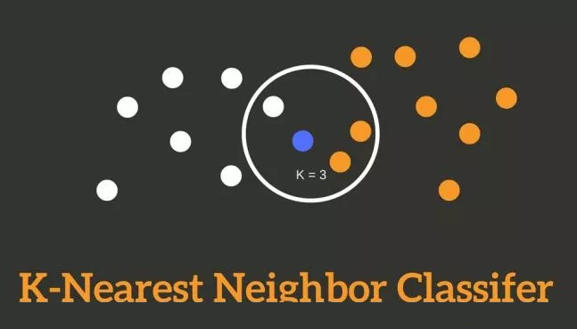
Copyright © www.ITbodhi.com
Notes:
1

Slide 2
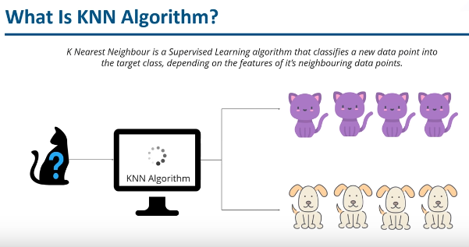
Image from Edureka
Copyright © www.ITbodhi.com
Notes:
1

Slide 3
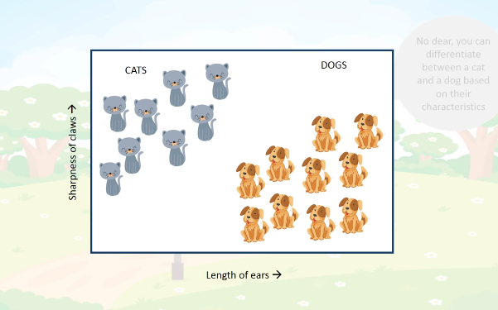
Image from Simpllearn
Copyright © www.ITbodhi.com
Notes:
1

Slide 4
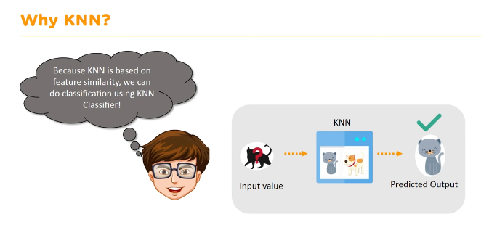
Image from Simpllearn
Copyright © www.ITbodhi.com
Notes:
1

Slide 5
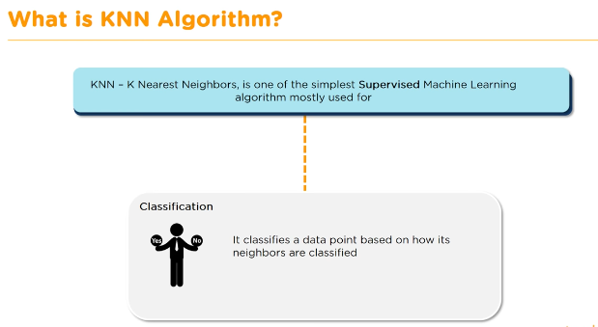
Image from Simpllearn
Copyright © www.ITbodhi.com
Notes:
1

Slide 6
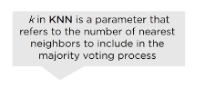
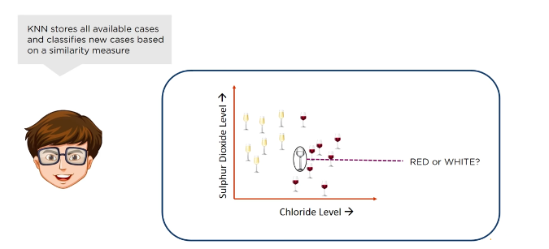
Image from Simpllearn
Copyright © www.ITbodhi.com
Notes:
1

Slide 7
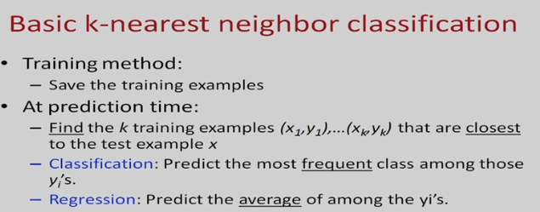
Image from Simpllearn
Copyright © www.ITbodhi.com
Notes:
1

Slide 8
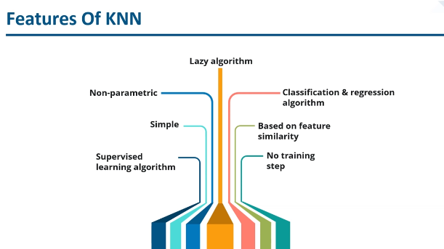
Image from Edureka
Copyright © www.ITbodhi.com
Notes:
1

Slide 9
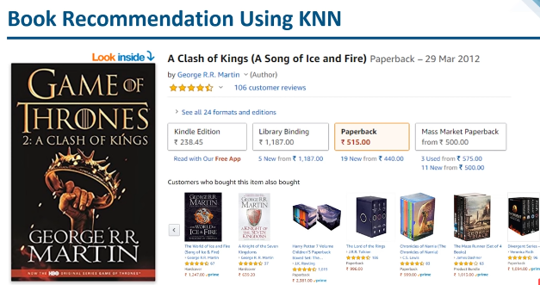
Copyright © www.ITbodhi.com
Notes:
1

Slide 10
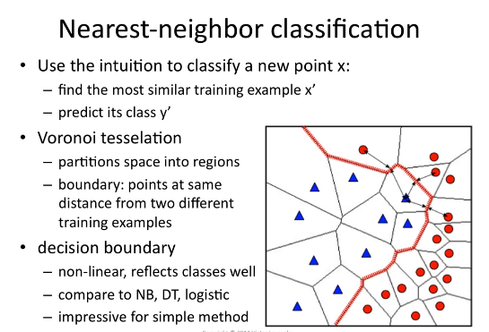
Copyright © www.ITbodhi.com
Notes:
1

Slide 11
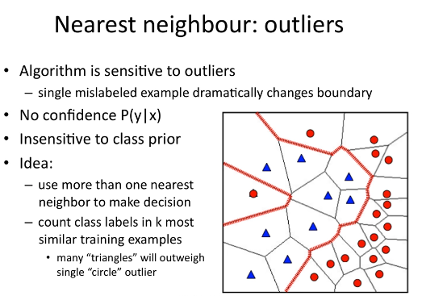
Copyright © www.ITbodhi.com
Notes:
1

Slide 12
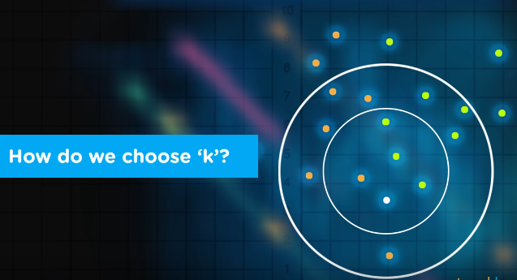
Image from Simpllearn
Copyright © www.ITbodhi.com
Notes:
1

Slide 13
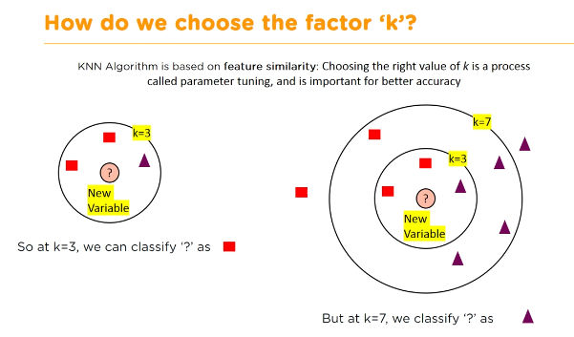
Image from Simpllearn
Copyright © www.ITbodhi.com
Notes:
1

Slide 14
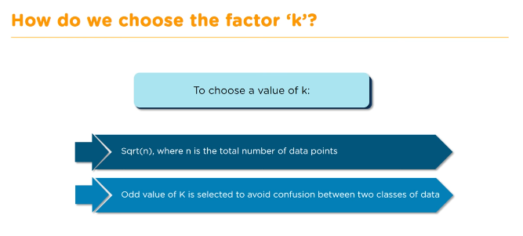
Image from Simpllearn
Copyright © www.ITbodhi.com
Notes:
1

Slide 15
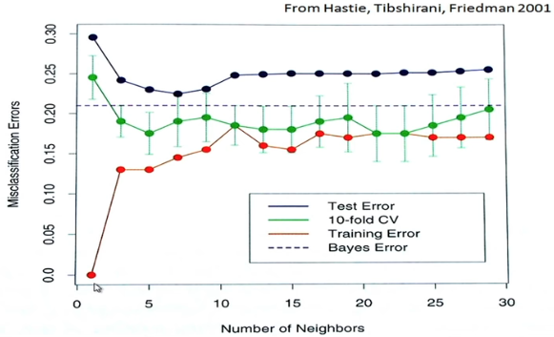
Image from Simpllearn
Copyright © www.ITbodhi.com
Notes:
1

Slide 16
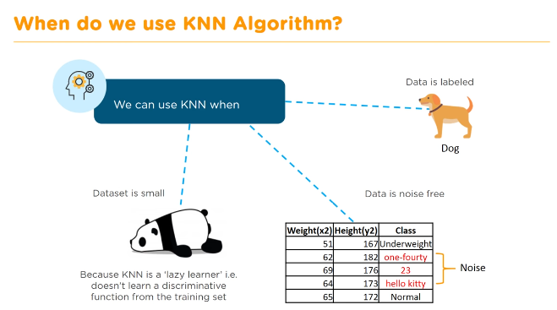
Image from Simpllearn
Copyright © www.ITbodhi.com
Notes:
1

Slide 17
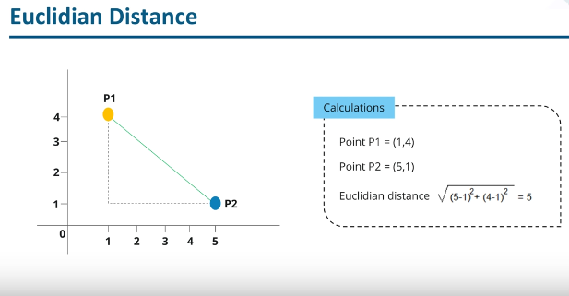
Image from Edureka
Copyright © www.ITbodhi.com
Notes:
1

Slide 18
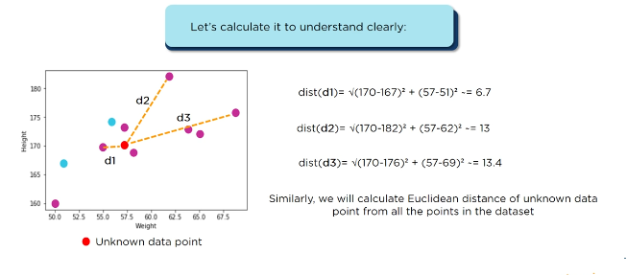
Image from Edureka
Copyright © www.ITbodhi.com
Notes:
1

Slide 19
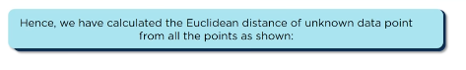
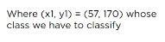
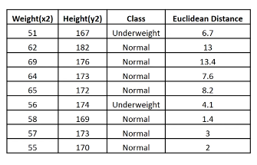
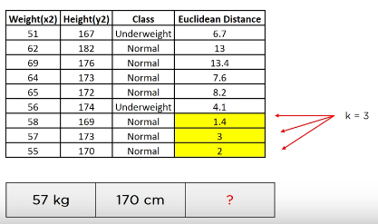
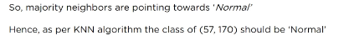
Image from Edureka
Copyright © www.ITbodhi.com
Notes:
1

Slide 20
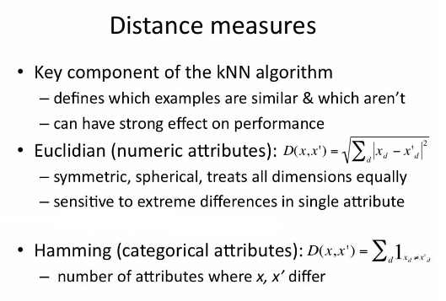
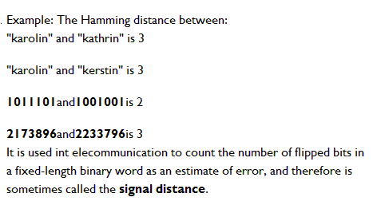
Manhattan distance is often used in integrated circuits where wires only run parallel to the X or Y axis.
It is also known as rectilinear distance, Minkowski’s L1 distance, taxi cab metric, or city block distance.
Copyright © www.ITbodhi.com
Notes:
Assumption with Euclidean distance:
Weight of all the features are considered same.
Scale of all the features are considered same.
Larger K
Use weighted eucledian distance
What to be done:
Scaling all attributes to same range.
1

Slide 21
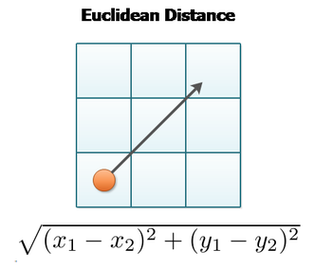
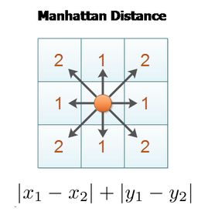
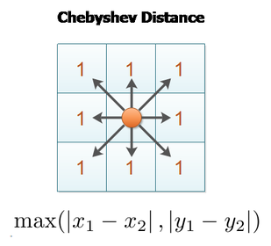
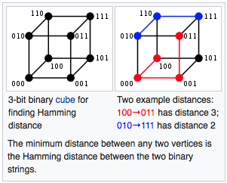
Copyright © www.ITbodhi.com

Slide 22
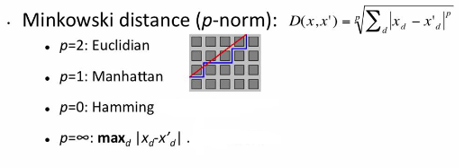
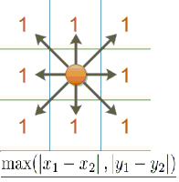
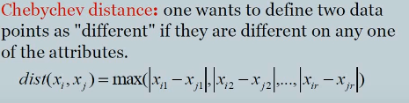
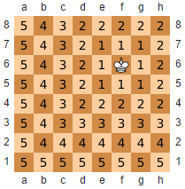
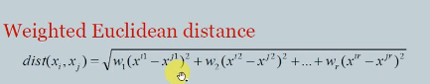
: Chebyshev
Chebyshev distance:
It is also known as chess board distance, since in the game of chess the minimum number of moves needed by a king to go from one square on a chess board to another equals the Chebyshev distance between the centers of the squares
Copyright © www.ITbodhi.com
Notes:
1

Slide 23
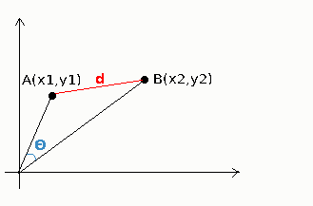
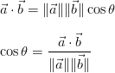
The Cosine Similarity
The cosine similarity between two vectors (or two documents on the Vector Space) is a measure that calculates the cosine of the angle between them.
This metric is a measurement of orientation and not magnitude.
When to Use Cosine?
Cosine similarity is generally used as a metric for measuring distance when the magnitude of the vectors does not matter. This happens for example when working with text data represented by word counts. We could assume that when a word (e.g. science) occurs more frequent in document 1 than it does in document 2, that document 1 is more related to the topic of science. However, it could also be the case that we are working with documents of uneven lengths (Wikipedia articles for example). Then, science probably occurred more in document 1 just because it was way longer than document 2. Cosine similarity corrects for this.
Copyright © www.ITbodhi.com
Notes:
1

Slide 24
Best data practice for KNN
Rescale Data: KNN performs much better if all of the data has the same scale. Normalizing your data to the range [0, 1] is a good idea. It may also be a good idea to standardize your data if it has a Gaussian distribution.
Address Missing Data: Missing data will mean that the distance between samples can not be calculated. These samples could be excluded or the missing values could be imputed.
Lower Dimensionality: KNN is suited for lower dimensional data. You can try it on high dimensional data (hundreds or thousands of input variables) but be aware that it may not perform as well as other techniques. KNN can benefit from feature selection that reduces the dimensionality of the input feature space.
Copyright © www.ITbodhi.com
Notes:
1

Slide 25
Pros of K Nearest Neighbors
Simple algorithm and hence easy to interpret the prediction
Non parametric, so makes no assumption about the underlying data pattern
used for both classification and Regression
Training step is much faster for nearest neighbor compared to other machine learning algorithms
Cons of K Nearest Neighbors
KNN is computationally expensive as it searches the nearest neighbors for the new point at the prediction stage
High memory requirement as KNN has to store all the data points
Prediction stage is very costly
Sensitive to outliers, accuracy is impacted by noise or irrelevant data.
Copyright © www.ITbodhi.com
Notes:
1

Slide 26
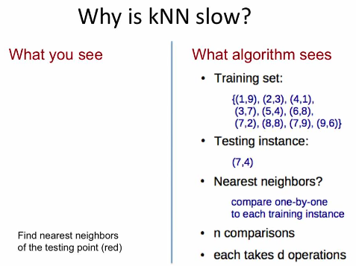
Copyright © www.ITbodhi.com
Notes:
1

Slide 27
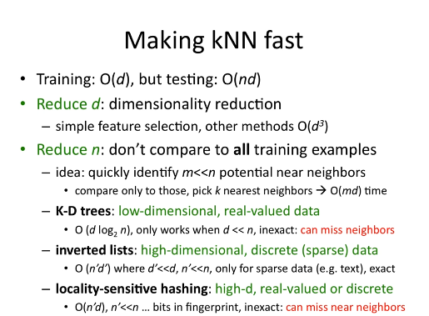
Copyright © www.ITbodhi.com
Notes:
1

Slide 28
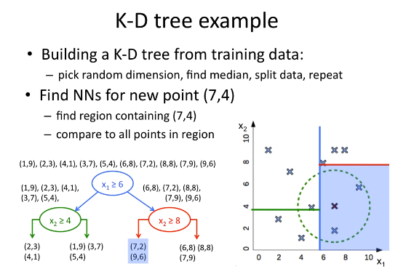
Copyright © www.ITbodhi.com
Notes:
1

Slide 29
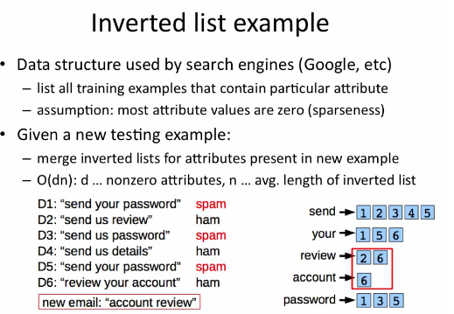
Copyright © www.ITbodhi.com
Notes:
1

Slide 30
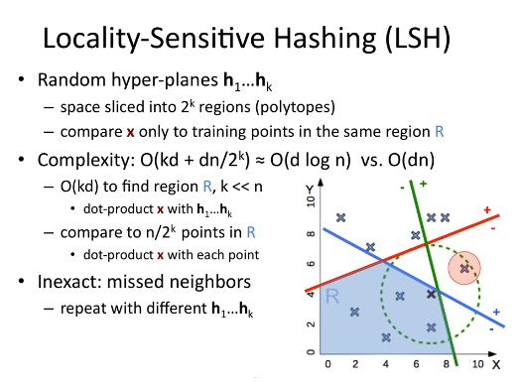
Copyright © www.ITbodhi.com
Notes:
1

Slide 31
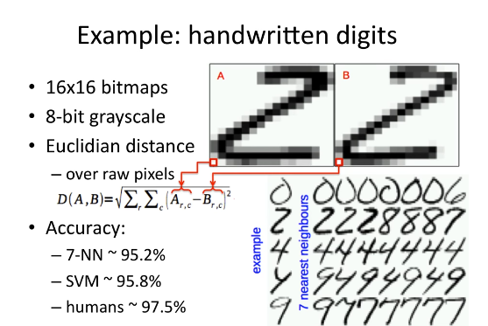
Copyright © www.ITbodhi.com
Notes:
1

Slide 32
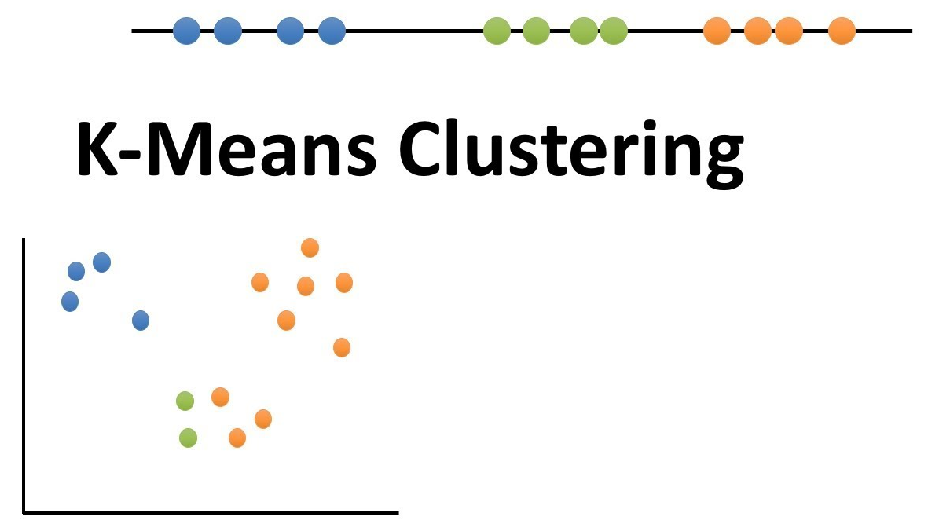
Copyright © www.ITbodhi.com
Notes:
1

Slide 33
Clustering is a method of unsupervised learning
where the data we want to describe is not labeled.
Where user does not give us much information of what is the expected output.
Grouping of data points.
Given a set of data points, clustering algorithm classify each data point into a specific group.
Data points that are in the same group should have similar properties and/or features.
Data points in different groups should have highly dissimilar properties and/or features.
Copyright © www.ITbodhi.com
Notes:
1

Slide 34
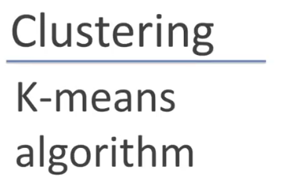
Image from AndrewNG
Copyright © www.ITbodhi.com
Notes:
1

Slide 35
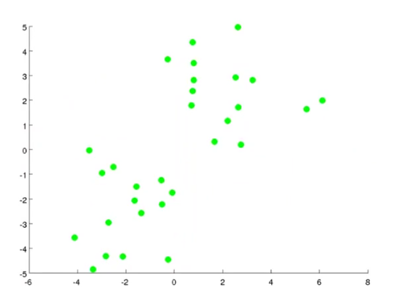
Given all the unlabeled data points
Image from AndrewNG
Copyright © www.ITbodhi.com
Notes:
1

Slide 36
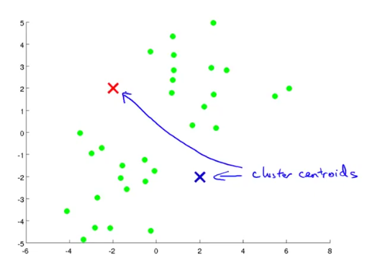
First select a number of classes/groups for clustering.
Randomly initialize their respective center points called cluster centroids.
Image from AndrewNG
Copyright © www.ITbodhi.com
Notes:
1

Slide 37
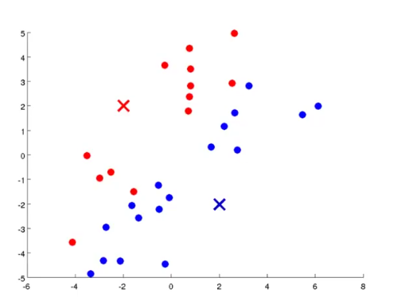
Each data point is classified by computing the distance between that point and each centroid and then classifying the point to be in the group whose center is closest to it.
Image from AndrewNG
Copyright © www.ITbodhi.com
Notes:
1

Slide 38
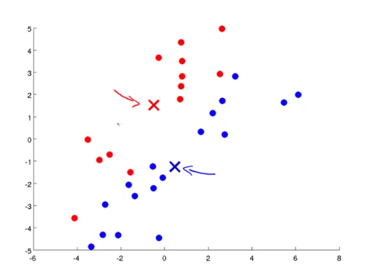
Based on these classified points, re-compute the group center by taking the mean of all the data point vectors in the group and shift the centroids.
Image from AndrewNG
Copyright © www.ITbodhi.com
Notes:
1

Slide 39
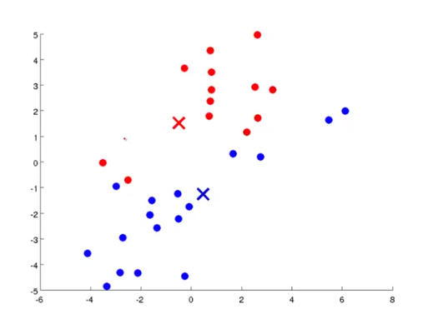
Now again calculate the distance of each data point vectors from the new position of centroids and assign them to any of the centroids on the basis of the minimum distance.
Image from AndrewNG
Copyright © www.ITbodhi.com
Notes:
1

Slide 40



Repeat these steps for a set number of iterations or until the group centers don’t change much between iterations.
Image from AndrewNG
Copyright © www.ITbodhi.com
Notes:
1

Slide 41

Image from AndrewNG
Copyright © www.ITbodhi.com
Notes:
1

Slide 42

Image from AndrewNG
Copyright © www.ITbodhi.com
Notes:
1

Slide 43

Image from AndrewNG
Copyright © www.ITbodhi.com
Notes:
1

Slide 44

Image from AndrewNG
Copyright © www.ITbodhi.com
Notes:
1

Slide 45

Clustering gets affected by the random initialization of the centroids.
Image from AndrewNG
Copyright © www.ITbodhi.com
Notes:
1

Slide 46

If 2=<K <= 10 random initialization has greater impact on clustering but if k>=10 random initialization has very less impact on clustering and most probably very first random initialization of centroids will give pretty good result..
Image from AndrewNG
Copyright © www.ITbodhi.com
Notes:
1

Slide 47

Image from AndrewNG
Copyright © www.ITbodhi.com
Notes:
1

Slide 48


Image from AndrewNG
Copyright © www.ITbodhi.com
Notes:
1

Slide 49

Image from AndrewNG
Copyright © www.ITbodhi.com
Notes:
1

Slide 50

Image from AndrewNG
Copyright © www.ITbodhi.com
Notes:
1

Slide 51
Top 5 Clustering Algorithms
K-Means Clustering
Mean-Shift Clustering
Density-Based Spatial Clustering of Applications with Noise (DBSCAN)
Expectation–Maximization (EM) Clustering using Gaussian Mixture Models (GMM)
Agglomerative Hierarchical Clustering
https://towardsdatascience.com/the-5-clustering-algorithms-data-scientists-need-to-know-a36d136ef68
Image from AndrewNG
Copyright © www.ITbodhi.com
Notes:
1

Slide 52

Image from AndrewNG
Copyright © www.ITbodhi.com
Notes:
1

Slide 53

Image from AndrewNG
Copyright © www.ITbodhi.com
Notes:
1

Slide 54

Image from AndrewNG
Copyright © www.ITbodhi.com
Notes:
<number>

